Slide 1


Distributed and Scalable Data Engineering
FINAL TERM PROJECT
Prof. Dr. Ardiana Sula

Slide 2
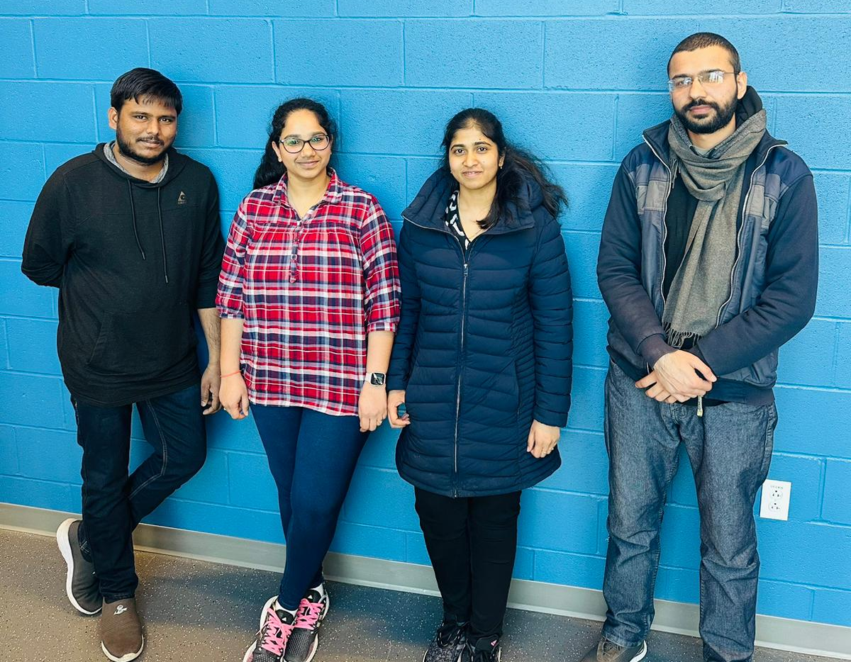
Meet our team: Team 2 Yegneshwar Rao Ginjupalli_Data Engineer Sreeja Garlapati_Data Scientist Srividhya Pasam_Data Analyzer Khalil Malik Muhammad_ML Engineer

Slide 3
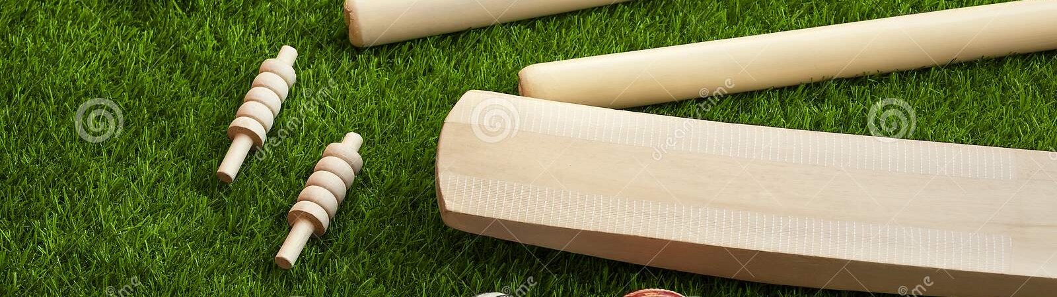
Data Engineering and Analysis of T-20 Cricket World cup

Slide 4
3 Cs and Why?
Curiosity:
We were curious about data engineering and analysis of the T-20 Cricket World Cup to understand the patterns and insights from the data to improve performance and gain a competitive advantage.
Connections:
By analyzing the data of the T-20 Cricket World Cup, we can establish connections between different variables and identify key factors that contribute to the success of teams.
Creating Value:
Analyzing the data of the T-20 Cricket World Cup can create value by helping teams make data-driven decisions, optimize their strategies, and improve their chances of winning.

Slide 5

Creating Value:
The value of analyzing data engineering and analysis of the T-20 Cricket World Cup lies in gaining insights into the performance of teams and identifying patterns that can help improve their strategies. This can lead to better decision-making and ultimately, increased chances of success in the tournament. Additionally, it can provide a competitive advantage by identifying strengths and weaknesses of different teams and players.

Slide 6
CRISP DM:
Business understanding - To form a new cricket team of 11 best players for the Indian Premier League IPL.
Data understanding - Gather, assess and explore the relevant data from various sources like ESPN, Cricinfo website to understand its structure and quality.
Data preparation - Clean, transform and prepare the data to make it ready for modeling by using web-scrapping, Excel and python.
Modeling - Choose appropriate modeling techniques like SQL and PowerBI reports to derive insights from the data.
Evaluation - The performance of the players is evaluated and then visualized using the graphs and histograms to finalize the team of 11 members.
Deployment - Communicate the results to the Board members and deploy the models in a web page for ongoing use.

Slide 7







Data from Various Sources
Evaluation
Data Collection and Preparation
Web-Scrapping
Deployment
Data Modelling
Detailed Flow Chart

Slide 8
Openers/Strikers:
Filter
PARAMETERS | DESCRIPTION | CRITERIA
Batting Average | Average Runs Scored in an Innings | >30
Strike Rate | No of runs scored per 100 balls | >140
Innings Batted | Total Innings Batted | >3
Boundary % | % of runs scored in Boundaries | >50
Batting Position | Batting order | <4

Slide 9
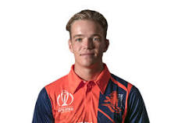
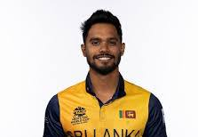
Openers/Strikers:
Best 11 Players
Name
Image
Team
Role
Innings
Runs
Balls
Bas de Leede
Netherland
Opener
8
93
93
Dhananjaya de Silva
Sri Lanka
All-Rounder
177
72
All-Rounder
8

Slide 10
Middle Order Anchors:
Filter
PARAMETERS | DESCRIPTION | CRITERIA
Batting Average | Average Runs Scored in an Innings | >0
Strike Rate | No of runs scored per 100 balls | >125
Innings Batted | Total Innings Batted | >3
Average Balls Faced | Average of Faced Balls in an Innings | >52
Batting Position | Batting order | <2

Slide 11
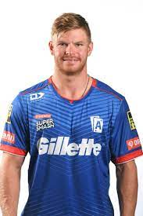
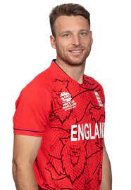
Middle Order Anchors:
Best 11 Players
Name
Image
Team
Role
Innings
Runs
Balls
Glenn Phillips
New Zealand
Wicket Keeper
5
201
-
Jos Buttler
England
Wicket Keeper
6
225
86
All-Rounder

Slide 12
Wicket Keepers/Lower Order Anchors:
Filter
PARAMETERS | DESCRIPTION | CRITERIA
Batting Average | Average Runs Scored in an Innings | >25
Strike Rate | No of runs scored per 100 balls | >130
Innings Batted | Total Innings Batted | >3
Average Balls Faced | Average of Faced Balls in an Innings | >12
Innings Bowled | Innings Bowled by Bowler | <1

Slide 13
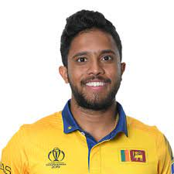
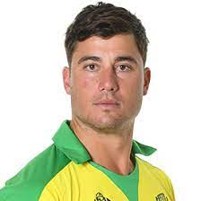
Lower Order Anchors:
Best 11 Players
Name
Image
Team
Role
Innings
Runs
Balls
Kusal Mendis
Sri Lanka
Wicket Keeper
8
223
-
Marcus Stoinis
Australia
All Rounder
4
126
-
All-Rounder

Slide 14
All Rounders :
Filter
PARAMETERS | DESCRIPTION | CRITERIA
Batting Average | Average Runs Scored in an Innings | >15
Strike Rate | No of runs scored per 100 balls | >140
Innings Batted | Total Innings Batted | >3
Average Balls Faced | Average of Faced Balls in an Innings | >30
Innings Bowled | Innings Bowled by Bowler | <2
Bowling Economy | Runs Allowed Per Over | <7
Bowling Strike Rate | Minimum Balls to take Wicket | <20

Slide 15
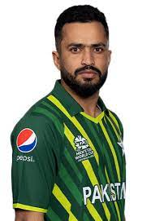
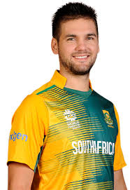
All Rounders:
Best 11 Players
Name
Image
Team
Role
Innings
Wicket
Balls
Mohammad Nawaz
Pakistan
All Rounder
5
6
68
Rilee Rossouw
South Africa
Top Batter
4
141
-
All-Rounder

Slide 16
Bowlers :
Filter
PARAMETERS | DESCRIPTION | CRITERIA
Batting Average | Average Runs Scored in an Innings | >15
Bowling Average | No of runs per wicket | <20
Dot Balls % | % of Dot Balls Bowled | >40
Bowling Style | Fast or Spinner | >30
Innings Bowled | Innings Bowled by Bowler | <5
Bowling Economy | Runs Allowed Per Over | <7
Bowling Strike Rate | Minimum Balls to take Wicket | <16

Slide 17
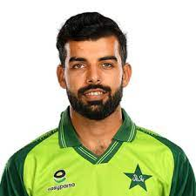
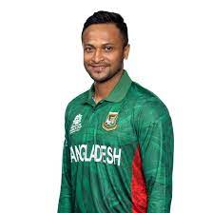
Bowlers:
Best 11 Players
Name
Image
Team
Role
Innings
Wicket
Balls
Shadab Khan
Pakistan
Fast Bowler
6
3
28
Shakib Al Hasan
Bangladesh
Fast Bowler
6
11
44
All-Rounder

Slide 18

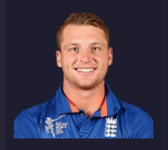
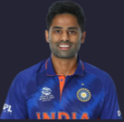
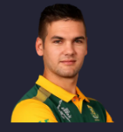


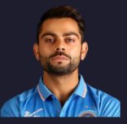


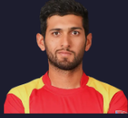
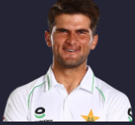
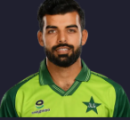
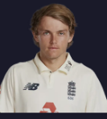
Output:
?
?
?
?
?
?
?
?
?
?
?

Slide 19
Deliverables:
Code File
PowerBI Reports
Video Demo
Github Link

Slide 20

Thank You!!!

